Slide 1














Market Price Prediction Using Time Series Analysis
Presented by
Arian Rahman Aditta

Slide 2

In the realm of market analysis and forecasting, understanding the intricate patterns within time series data is paramount for informed decision-making. With the advent of machine learning techniques, it's now possible to delve deeper into historical market data to predict future trends accurately. This project aims to develop a robust time series machine learning model to forecast market trends.
By leveraging advanced algorithms, we aim to predict the quantity and prices of commodities for future months. Accurate forecasting empowers stakeholders to make informed decisions regarding production, procurement, pricing strategies, and resource allocation, leading to enhanced efficiency and profitability through proactive decision-making. With a dataset containing monthly market data spanning multiple years, encompassing various regions, commodities, and pricing information, we are well-positioned to build a model that provides valuable insights for the market ecosystem.
Introduction

Slide 3
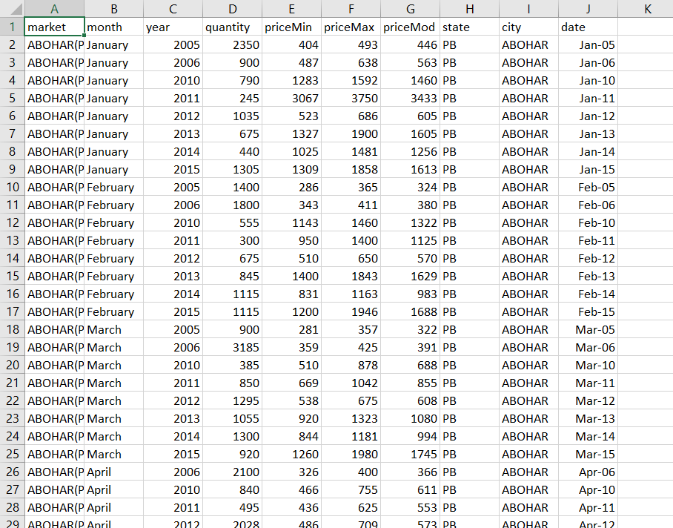
Data Description
Description:
The dataset includes monthly market data over multiple years, covering various regions, commodities, and pricing information.
Key columns:
Market: The market or commodity under consideration.
Month: The month for which the data is recorded.
Year: The year corresponding to the recorded data.
Quantity: The quantity of the commodity traded or available.
PriceMin: The minimum price of the commodity during the month.
PriceMax: The maximum price of the commodity during the month.
PriceMod: The mode or most frequently occurring price of the commodity during the month.
State: The state or region where the market is located.
City: The city where the market is situated.
Date: The specific date of the recorded data.

Slide 4
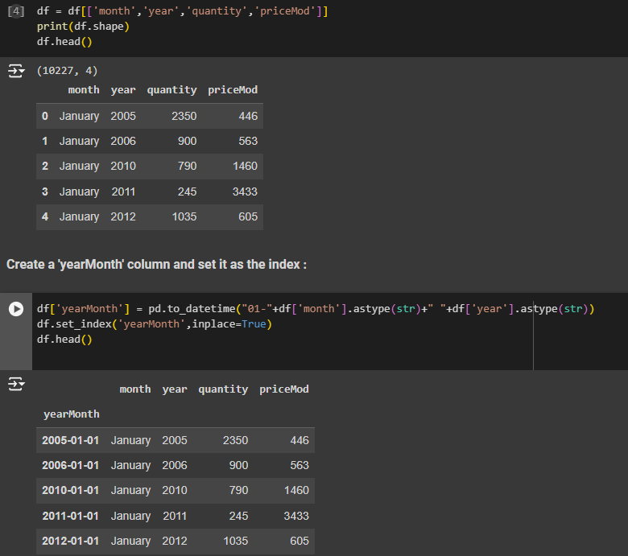
Data Preprocessing
Description:
Data preprocessing involves cleaning the dataset, handling missing values, and encoding categorical variables to prepare the data for analysis.
Steps undertaken:
Selecting and renaming necessary columns.
Creating a 'yearMonth' column and setting it as the index.

Slide 5
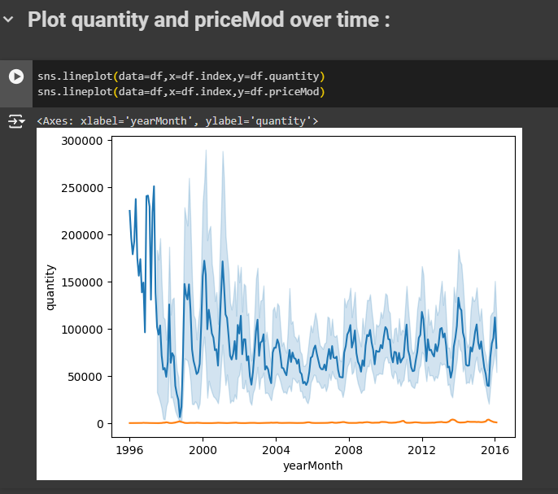
Exploratory Data Analysis (EDA)
Description:
EDA helps in analyzing temporal patterns, identifying seasonality, trends, and anomalies within the data.
Key techniques include line plots and rolling statistics.

Slide 6
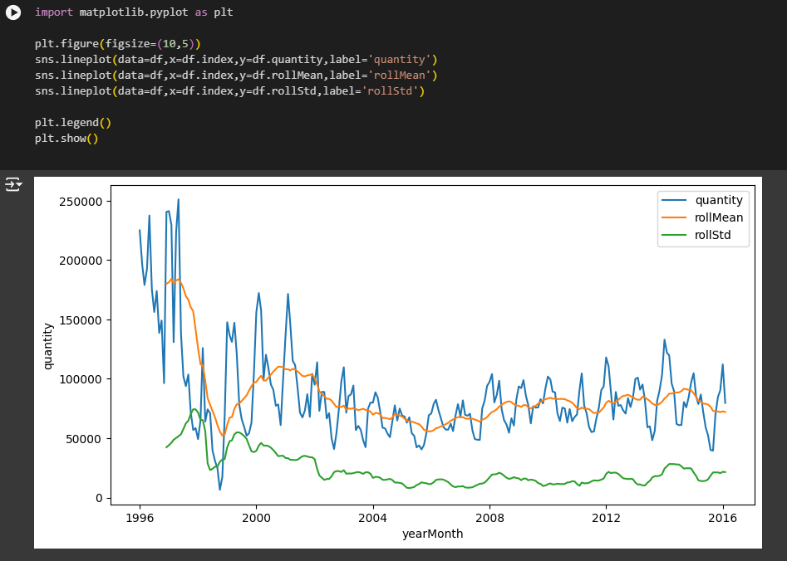
Exploratory Data Analysis (EDA)
Description: (Quantity)
- Rolling statistics, such as rolling mean and rolling standard deviation, are computed over a specified window of time.
- The rolling mean helps smooth out fluctuations in the quantity data, revealing underlying trends over time.
- Rolling standard deviation quantifies the variability or dispersion of the quantity values, aiding in understanding the volatility of the data.
- By analyzing rolling statistics, we gain insights into the overall behavior of the quantity variable, which is crucial for market analysis and forecasting.

Slide 7
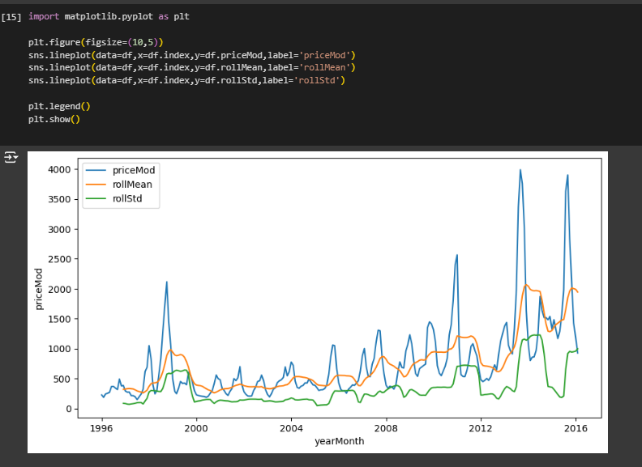
Exploratory Data Analysis (EDA)
Description: (Price)
Rolling statistics, including rolling mean and rolling standard deviation, are calculated over a defined time window for the priceMod variable.
The rolling mean helps to smooth out short-term fluctuations in the priceMod data, providing insights into long-term trends or patterns.
Rolling standard deviation measures the variability or dispersion of the priceMod values within the specified time window, indicating the level of volatility in the data.
Analyzing rolling statistics for priceMod offers valuable insights into the price dynamics over time, assisting in market analysis and forecasting.

Slide 8
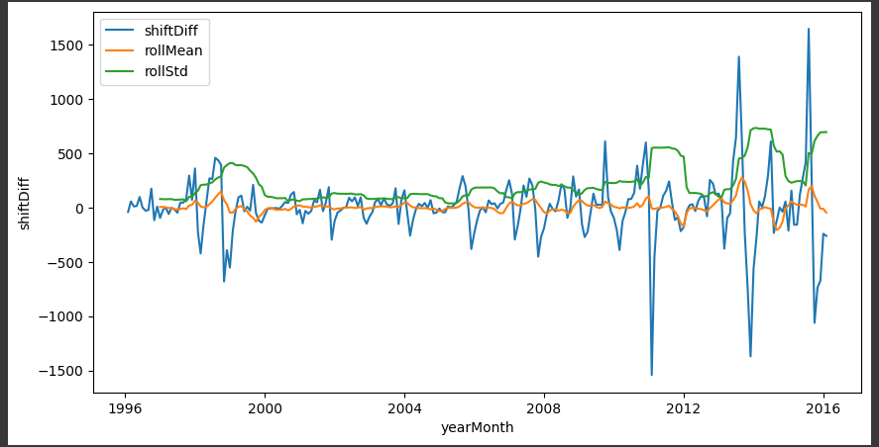
Feature Engineering
Description: (Price)
Creating relevant features such as lagged variables, rolling statistics, and seasonal indicators to enhance model performance.
Steps undertaken:
Calculating rolling statistics for 'priceMod'.
Stationarity transformation and differencing.
Log transformation for stabilizing variance.

Slide 9
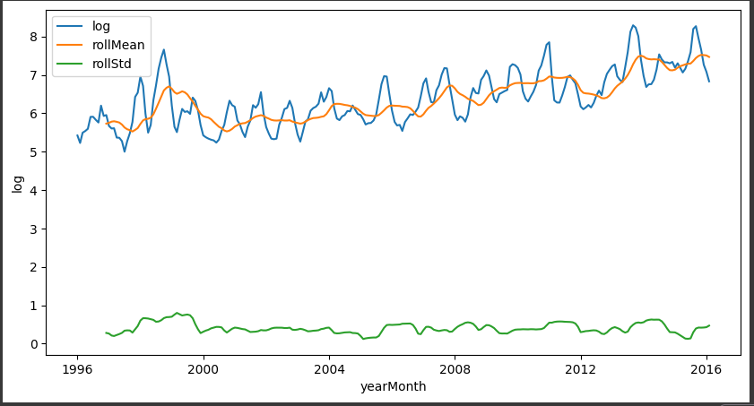
Feature Engineering
Stationarity transformation and differencing: Transforming time series data to achieve stationarity is crucial for accurate forecasting. Differencing involves computing the differences between consecutive observations to remove trends or seasonal patterns, ensuring constant statistical properties over time.
Log transformation for stabilizing variance: Log transformation reduces the magnitude of fluctuations in time series data, particularly for variables with large variations. By stabilizing the variance, log transformation mitigates heteroscedasticity and makes the data more suitable for analysis and modeling, enhancing the performance of forecasting models.

Slide 10
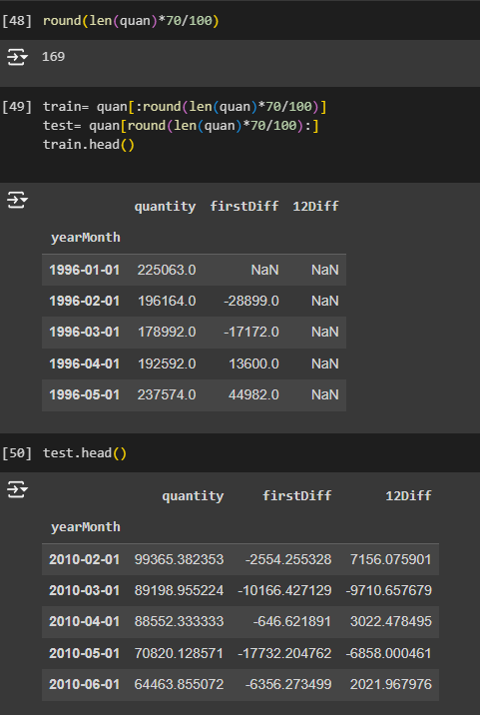
Model Selection and Training
Description:
Evaluating various time series forecasting models such as ARIMA and SARIMA.
Selecting the most suitable model and training it on the dataset.

Slide 11
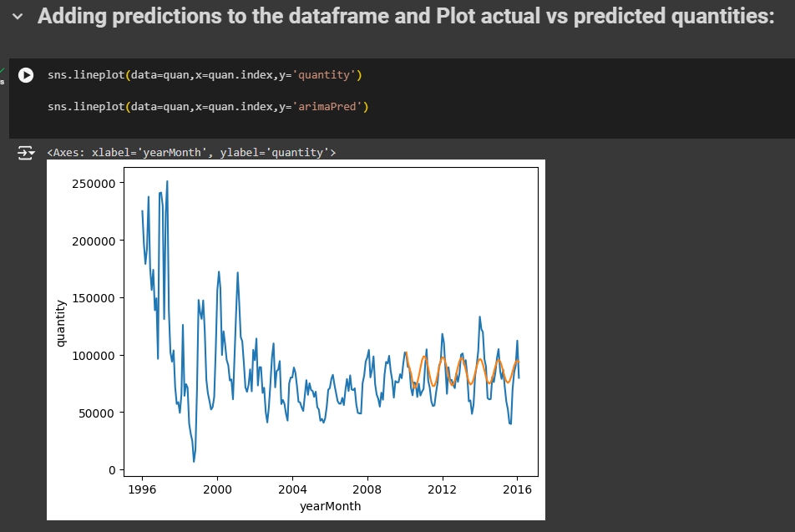
Model Selection
ARIMA (AutoRegressive Integrated Moving Average):
ARIMA is a widely used time series forecasting model that combines autoregression (AR), differencing (I), and moving average (MA) components. It is suitable for univariate time series data with trends and no seasonality. The ARIMA model is effective for making short-term forecasts by analyzing historical patterns and trends in the data. In this project, we trained an ARIMA model on our dataset to forecast future market quantities and prices.

Slide 12
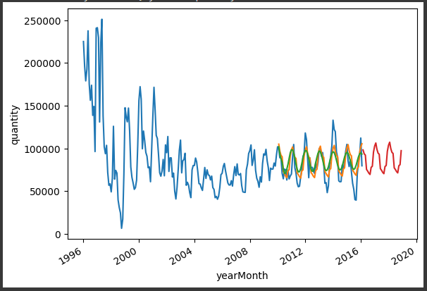
Model Selection
SARIMAX (Seasonal AutoRegressive Integrated Moving Average with Exogenous Variables):
SARIMAX is an extension of the ARIMA model that incorporates seasonal components and exogenous variables. It is suitable for time series data with both trend and seasonal patterns. SARIMAX models consider additional factors such as seasonality and external variables to make more accurate forecasts. In our project, we trained a SARIMAX model on the dataset to predict future market quantities and prices.

Slide 13
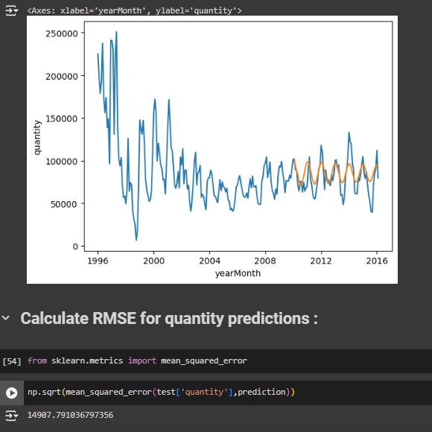
Model Evaluation (Quantity)
Description:
Assessing the model's performance using appropriate metrics such as Mean Absolute Error (MAE), Mean Squared Error (MSE), and Root Mean Squared Error (RMSE)

Slide 14
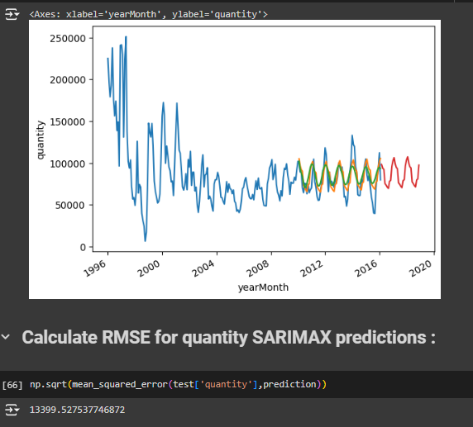
Model Evaluation
(Quantity)
ARIMA Model Evaluation:
The ARIMA model showed relatively higher loss metrics compared to SARIMAX. This suggests that the ARIMA model may not capture all the underlying patterns and seasonal variations present in the data. The higher values of MAE, MSE, and RMSE indicate that the ARIMA model's predictions deviated significantly from the actual values, resulting in less accurate forecasts.
SARIMAX Model Evaluation:
In contrast, the SARIMAX model exhibited lower loss metrics, indicating better performance in predicting future market quantities and prices. The lower values of MAE, MSE, and RMSE suggest that the SARIMAX model effectively captured the underlying trends, seasonal patterns, and exogenous variables, resulting in more accurate forecasts.

Slide 15
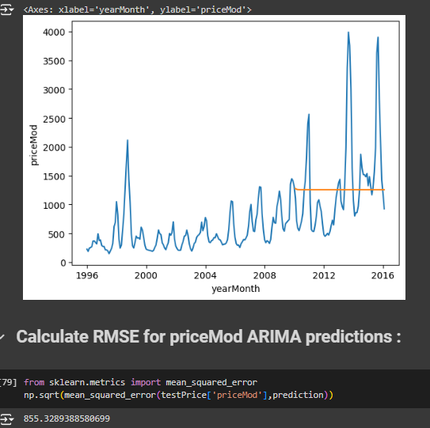
Model Evaluation (Price)
Description:
Assessing the model's performance using appropriate metrics such as Mean Absolute Error (MAE), Mean Squared Error (MSE), and Root Mean Squared Error (RMSE)

Slide 16
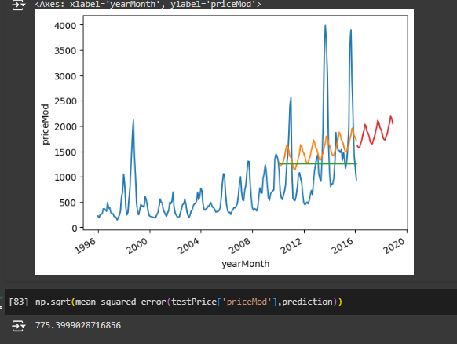
Model Evaluation
(Price)
ARIMA Model Evaluation:
The ARIMA model showed relatively higher loss metrics compared to SARIMAX. This suggests that the ARIMA model may not capture all the underlying patterns and seasonal variations present in the data. The higher values of MAE, MSE, and RMSE indicate that the ARIMA model's predictions deviated significantly from the actual values, resulting in less accurate forecasts.
SARIMAX Model Evaluation:
In contrast, the SARIMAX model exhibited lower loss metrics, indicating better performance in predicting future market quantities and prices. The lower values of MAE, MSE, and RMSE suggest that the SARIMAX model effectively captured the underlying trends, seasonal patterns, and exogenous variables, resulting in more accurate forecasts.

Slide 17
Outcome
Despite diligent efforts, the ARMA model exhibited unsatisfactory performance, displaying a high root-mean-square error (RMSE) for both quantity and price predictions. Regrettably, it failed to accurately capture the intricate patterns within the dataset, highlighting significant shortcomings in its forecasting capabilities.
While the SARIMAX model demonstrated slightly better performance compared to ARMA, its predictive accuracy still fell short of expectations. Although it showed marginal improvement, it remains clear that substantial enhancements are necessary to achieve satisfactory results.
Overall, the models yielded mixed outcomes, accurately predicting some values while inaccurately forecasting others. This underscores the imperative for ongoing refinement and optimization to enhance model efficacy.
Looking ahead, there is a clear mandate to dedicate further efforts towards improving the model's performance. By refining algorithms, exploring additional features, and fine-tuning parameters, we aim to bolster predictive accuracy and reliability.

